Slide 1
INTRODUCTION IN JAVA - II
Day 2
PPT-Master Version 01. There will be an extensive update with the new Deutsche Bank font and sample charts at the end of August 2024.
8 May 2024, Speaker name

Slide 2
FOUR PILLARS OF OBJECT ORIENTED PROGRAMMING
Inheritance is a mechanism where a new class (child or subclass) inherits the properties and behavior (methods) of an existing class (parent or superclass). It promotes code reusability and establishes a natural hierarchical relationship between classes.
Polymorphism means "many shapes" and allows objects of different classes to be treated as objects of a common superclass. It enables a single interface to be used for a general class of actions, making it easier to manage and scale the code.
Abstraction is the concept of hiding the complex implementation details and showing only the essential features of the object. It simplifies the complexity by providing a simplified model of the system.
Encapsulation is the mechanism of wrapping the data (variables) and the code (methods) that manipulates the data into a single unit called a class. It restricts direct access to some of the object's components, which can prevent the accidental modification of data.

Slide 3
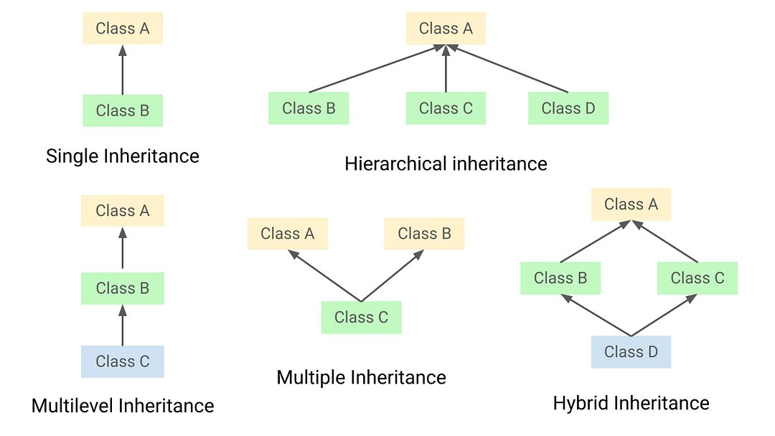
INHERITENCE

Slide 4
INHERITANCE
Inheritance allows to define new classes by reusing other classes, specifying just the differences.
It is possible to define a new class (subclass) by saying that the class must be like other class (superclass):
class ScientificBook extends Book { String area;
boolean proceeding = false;
}
Book
ScientificBook

Slide 5
INHERITANCE (HIERARCHY)
Object
String
Book
AbstractCollection
ScientificBook
Novel
ScienceFiction
Crime

Slide 6
INHERITANCE (CONSTRUCTORS)
class ScientificBook extends Book { String area;
boolean proceeding = false;
Book
ScientificBook(String tit, String aut, int num, String isbn, String a) {
super(tit,aut,num,isbn);
area = a;
}
Book(...)
ScientificBook
}
ScientificBook(...)
ScientificBook sb;
sb = new ScientificBook(
"Neural Networks",
"Simon Haykin",696,"0-02-352761-7",
"Artificial Intelligence");

Slide 7
INHERITANCE (CONSTRUCTORS)
title author
"Thinking in Java"
title author
"Neural Networks"
"Bruce Eckel"
"Simon Haykin"
numberOfPages
1129
numberOfPages
696
ISBN
"unknown"
ISBN
area
"0-02-352761-7"
"Artificial Intelligence"
b
sb
proceeding
false
Book b = new Book("Thinking in Java","Bruce Eckel",1129);
ScientificBook sb = new ScientificBook( "Neural Networks",
"Simon Haykin",696,"0-02-352761-7",
"Artificial Intelligence");

Slide 8
INHERITANCE (CONSTRUCTORS)
New methods can be defined in the subclass to specify the behavior of the objects of this class.
When a message is sent to an object, the method is searched for in the class of the receptor object.
If it is not found then it is searched for higher up in the hierarchy.

Slide 9
INHERITANCE (INHERITING METHODS)
title author
"Neural Networks"
Book
"Simon Haykin"
numberOfPages
696
getInitials()
ISBN
area
"0-02-352761-7"
"Artificial Intelligence"
ScientificBook
sb
proceeding
false
ScientificBook sb;
sb = new ScientificBook("Neural Networks","Simon Haykin", 696, "0-02-352761-7","Artificial Intelligence");
System.out.println(sb.getInitials());
S.H.

Slide 10
INHERITANCE (OVERRIDING METHODS)
Book
ScientificBook(String tit, String aut, int num, String isbn, String a) {
super(tit,aut,num,isbn);
area = a;
}
equals(...)
ScientificBook
public boolean equals(ScientificBook b){ return super.equals(b) &&
area.equals(b.area) &&
proceeding == b.proceeding;
}
equals(...)
}

Slide 11
INHERITANCE (OVERRIDING METHODS)
Two possible solutions:
public boolean equals(ScientificBook b){ return super.equals(b) && area.equals(b.area)
&& proceeding == b.proceeding;
}
public boolean equals(ScientificBook b) {
return (title.equals(b.title) && author.equals(b.author) && numberOfPages == b.numberOfPages
&& ISBN.equals(b.ISBN) && area.equals(b.area) && proceeding == b.proceeding;
}
Which one is better ?

Slide 12
INHERITANCE (OVERRIDING METHODS)
class ScientificBook extends Book { String area;
boolean proceeding = false;
Book
equals(...)
description(...)
ScientificBook(String tit, String aut, int num, String isbn, String a) {
...
}
public boolean equals(ScientificBook b){
...
}
ScientificBook
equals(...)
description(...)
public static String description() { return "ScientificBook instances can" +
" store information on " +
" scientific books";
}
}

Slide 13
INHERITANCE (NEW METHODS)
class ScientificBook extends Book { String area;
boolean proceeding = false;
Book
equals(...)
description(...)
ScientificBook(String tit, String aut, int num, String isbn, String a) {
super(tit,aut,num,isbn); area = a;
}
...
ScientificBook
equals(...)
description(...) setProceeding(...) isProceeding(...)
public void setProceeding() { proceeding = true;
}
public boolean isProceeding() { return proceeding;
}
}

Slide 14
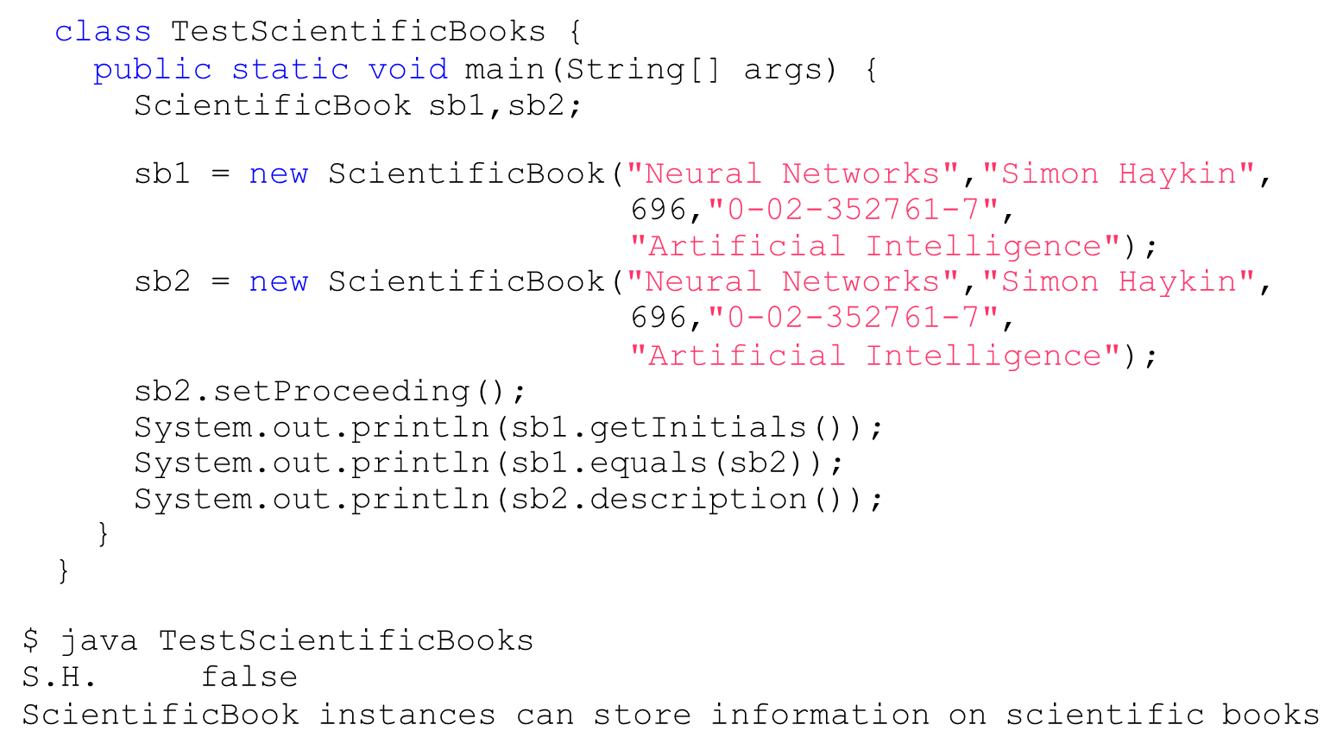
INHERITANCE (NEW METHODS)

Slide 15
getClass()
getClass() returns the runtime class of an object:
Book b1 = new Book("Thinking in Java","Bruce Eckel",1129);
System.out.println(b1.getClass().getName());
Book

Slide 16
Instanceof and getClass()
class TestClass {
public static void main(String[] args) {
Book b1 = new Book("Thinking in Java","Bruce Eckel",1129); ScientificBook sb1 = new ScientificBook("Neural Networks",
"Simon Haykin",696,"0-02-352761-7",
"Artificial Intelligence");
System.out.println(b1.getClass().getName()); System.out.println(sb1.getClass().getName()); System.out.println(b1 instanceof Book); System.out.println(sb1 instanceof Book); System.out.println(b1 instanceof ScientificBook); System.out.println(sb1 instanceof ScientificBook);
}
}
$ java TestClass class Book
class ScientificBook
true true false true

Slide 17
POLYMORPHISM
// Base class
class Animal {
public void speak() {
System.out.println("Animal makes a sound");
}
}
// Derived classes
class Dog extends Animal {
@Override
public void speak() {
System.out.println("Dog barks");
}
}
class Cat extends Animal {
@Override
public void speak() {
System.out.println("Cat meows");
}
}
class Cow extends Animal {
@Override
public void speak() {
System.out.println("Cow moos");
}
}
public class Main {
public static void animalSound(Animal animal)
{ animal.speak(); }
public static void main(String[] args) {
Animal dog = new Dog();
Animal cat = new Cat();
Animal cow = new Cow();
animalSound(dog);
}
}

Slide 18
FINAL AND ABSTRACT
The modifiers final and abstract can be applied to classes and methods:
final:
A final class does not allow subclassing.
A final method cannot be redefined in a subclass.
abstract:
An abstract class is a class that cannot be instantiated.
An abstract method has no body, and it must be redefined in a subclass.

Slide 19
FINAL AND ABSTRACT
An example: the class IOBoard and its subclasses.
IOBoard
IOEthernetBoard
IOSerialBoard

Slide 20
FINAL AND ABSTRACT
abstract class IOBoard { String name;
int numErrors = 0;
IOBoard(String s) { System.out.println("IOBoard constructor"); name = s;
}
final public void anotherError() { numErrors++;
}
final public int getNumErrors() { return numErrors;
}
abstract public void initialize(); abstract public void read(); abstract public void write(); abstract public void close();
}

Slide 21
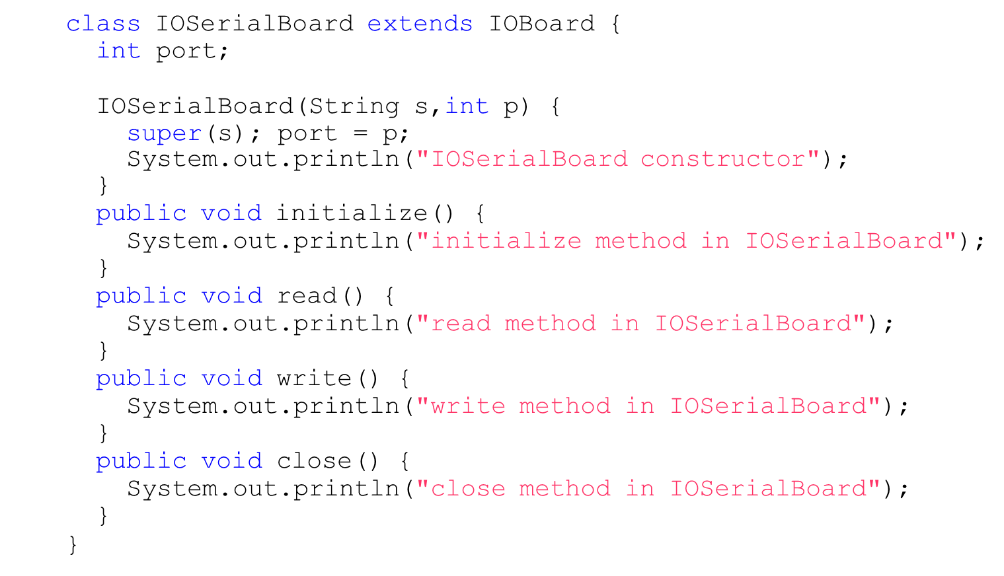
FINAL AND ABSTRACT

Slide 22
FINAL AND ABSTRACT
class IOEthernetBoard extends IOBoard { long networkAddress;
IOEthernetBoard(String s,long netAdd) { super(s); networkAddress = netAdd;
System.out.println("IOEthernetBoard constructor");
}
public void initialize() {
System.out.println("initialize method in IOEthernetBoard");
}
public void read() {
System.out.println("read method in IOEthernetBoard");
}
public void write() {
System.out.println("write method in IOEthernetBoard");
}
public void close() {
System.out.println("close method in IOEthernetBoard");
}
}

Slide 23
FINAL AND ABSTRACT
Creation of a serial board instance:
class TestBoards1 {
public static void main(String[] args) {
IOSerialBoard serial = new IOSerialBoard("my first port",
0x2f8);
serial.initialize(); serial.read(); serial.close();
}
}
$ java TestBoards1 IOBoard constructor IOSerialBoard constructor
initialize method in IOSerialBoard read method in IOSerialBoard close method in IOSerialBoard

Slide 24
INTERFACES
An interface describes what classes should do, without specifying how they should do it.
An interface looks like a class definition where:
all fields are static and final
all methods have no body and are public
no instances can be created from interfaces.

Slide 25
INTERFACES
An interface for specifying IO boards behavior:
interface IOBoardInterface {
public | void | initialize();
public | void | read();
public | void | write();
public | void | close();
}
An interface for specifying nice behavior:
interface NiceBehavior { public String getName(); public String getGreeting(); public void sayGoodBye();
}

Slide 26
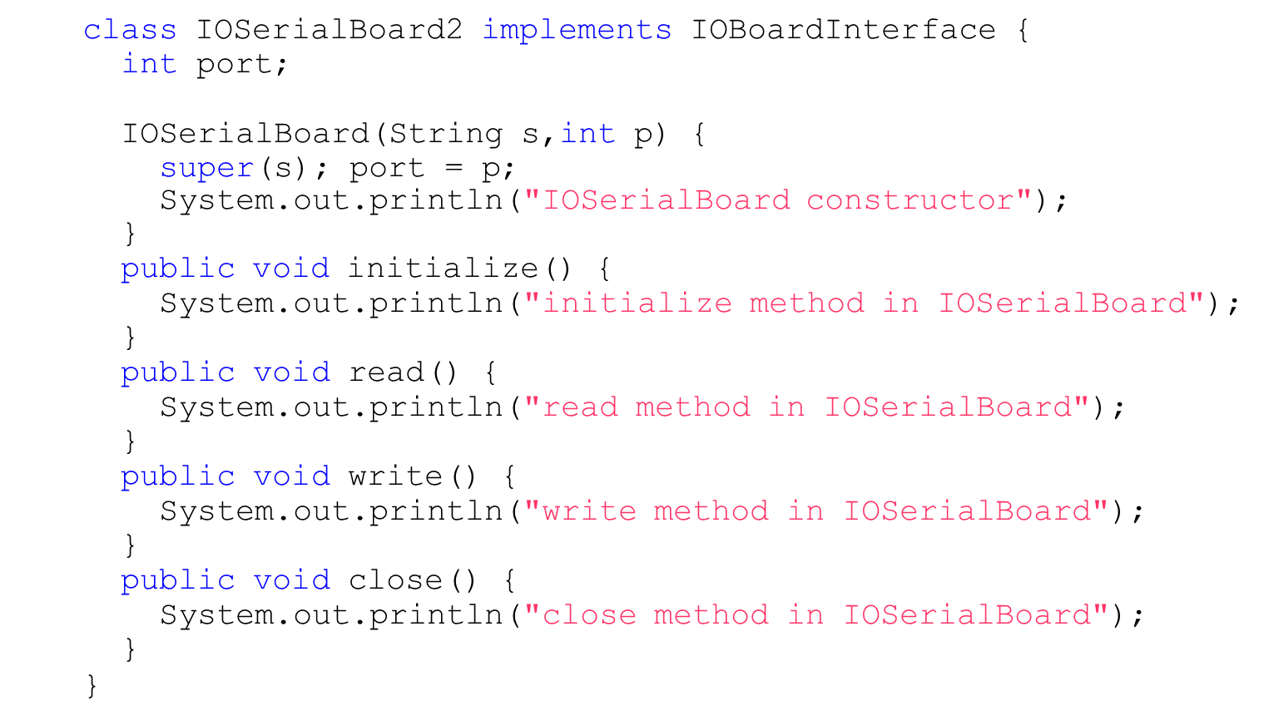
INTERFACES

Slide 27
INTERFACES
A class can implement more than one interface.
class IOSerialBoard2 implements IOBoardInterface,
NiceBehavior {
....
}
Which methods should it implement ?

Slide 28
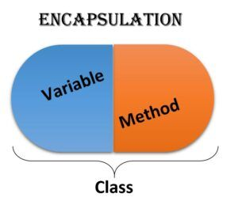
ENCAPSULATION
Encapsulation in Java is the principle of bundling the data (attributes) and methods (behaviors) that operate on the data into a single unit called a class. It helps in hiding the internal state of an object from outside interference and manipulation.

Slide 29
ENCAPSULATION
// Class with encapsulated data and methods
class Person {
private String name;
private int age;
// Constructor
public Person(String name, int age) {
this.name = name;
this.age = age;
}
// Getter for name public String getName() { return name;
}
// Setter for name public void setName(String name) {
this.name = name;
}
// Getter for age public int getAge() {
return age;
}
// Setter for name
public void setName(String name) {
this.name = name;
}
// Getter for age
public int getAge() {
return age;
}
// Setter for age
public void setAge(int age) {
this.age = age;
}
}
// Main class to demonstrate encapsulation
public class Main {
public static void main(String[] args) {
// Create an object of Person
Person person = new
Person("Alice", 30);

Slide 30
ENCAPSULATION
// Access and modify attributes using getter and setter methods
System.out.println("Name: " + person.getName() + ", Age: " + person.getAge());
person.setName("Bob");
person.setAge(25);
System.out.println("Updated Name: " + person.getName() + ", Updated Age: " + person.getAge());
}
}

Slide 31
EXCEPTIONS
The usual behavior on runtime errors is to abort the execution:
class TestExceptions1 {
public static void main(String[] args) {
String s = "Hello"; System.out.print(s.charAt(10));
}
}
$ java TestExceptions1 Exception in thread "main"
java.lang.StringIndexOutOfBoundsException:
String index out of range: 10
at java.lang.String.charAt(String.java:499)
at TestExceptions1.main(TestExceptions1.java:11)

Slide 32
EXCEPTIONS
The exception can be trapped:
class TestExceptions2 {
public static void main(String[] args) {
String s = "Hello"; try {
System.out.print(s.charAt(10));
} catch (Exception e) { System.out.println("No such position");
}
}
$ java TestExceptions2 No such position

Slide 33
EXCEPTIONS
It is possible to specify interest on a particular exception:
class TestExceptions3 {
public static void main(String[] args) {
String s = "Hello"; try {
System.out.print(s.charAt(10));
} catch (StringIndexOutOfBoundsException e) { System.out.println("No such position");
}
}
$ java TestExceptions3 No such position

Slide 34
EXCEPTIONS
It is possible to send messages to an exception object:
class TestExceptions4 {
public static void main(String[] args) {
String s = "Hello"; try {
System.out.print(s.charAt(10));
} catch (StringIndexOutOfBoundsException e) { System.out.println("No such position"); System.out.println(e.toString());
}
}
$ java TestExceptions4 No such position
java.lang.StringIndexOutOfBoundsException:
String index out of range: 10

Slide 35
EXCEPTIONS
We can add multiple catch blocks and a finally clause:
class MultipleCatch {
public void printInfo(String sentence) { try {
// get first and last char before the dot char first = sentence.charAt(0);
char last = sentence.charAt(sentence.indexOf(".") - 1);
String out = String.format("First: %c Last: %c",first, System.out.println(out);
} catch (StringIndexOutOfBoundsException e1) {
System.out.println("Wrong sentence, no dot?");
} catch (NullPointerException e2) { System.out.println("Non valid string");
} finally {
System.out.println("done!");
last);
}
}
}

Slide 36
EXCEPTIONS
class MultipleCatch {
public void printInfo(String sentence) { try {
// get first and last char before the dot char first = sentence.charAt(0);
char last = sentence.charAt(sentence.indexOf(".") - 1);
String out = String.format("First: %c Last: %c",first, last); System.out.println(out);
} catch (StringIndexOutOfBoundsException e1) {
System.out.println("Wrong sentence, no dot?");
} catch (NullPointerException e2) { System.out.println("Non valid string");
} finally {
System.out.println("done!");
}
}
String sentence = "A test sentence.";
MultipleCatch mc = new MultipleCatch(); mc.printInfo(sentence);
First: A Last: e done!

Slide 37
EXCEPTIONS
class MultipleCatch {
public void printInfo(String sentence) { try {
// get first and last char before the dot char first = sentence.charAt(0);
char last = sentence.charAt(sentence.indexOf(".") - 1);
String out = String.format("First: %c Last: %c",first, last); System.out.println(out);
} catch (StringIndexOutOfBoundsException e1) {
System.out.println("Wrong sentence, no dot?");
} catch (NullPointerException e2) { System.out.println("Non valid string");
} finally {
System.out.println("done!");
}
}
String sentence = "A test sentence";
MultipleCatch mc = new MultipleCatch(); mc.printInfo(sentence);
Wrong sentence, no dot? done!

Slide 38
EXCEPTIONS
class MultipleCatch {
public void printInfo(String sentence) { try {
// get first and last char before the dot char first = sentence.charAt(0);
char last = sentence.charAt(sentence.indexOf(".") - 1);
String out = String.format("First: %c Last: %c",first, last); System.out.println(out);
} catch (StringIndexOutOfBoundsException e1) {
System.out.println("Wrong sentence, no dot?");
} catch (NullPointerException e2) { System.out.println("Non valid string");
} finally {
System.out.println("done!");
}
}
String sentence = null;
MultipleCatch mc = new MultipleCatch(); mc.printInfo(sentence);
Non valid string done!

Slide 39
EXCEPTIONS
There exists a set of predefined exceptions that can be caught.
In some cases it is compulsory to catch exceptions.
It is also possible to express the interest to not to catch even compulsory exceptions.

Slide 40
STRING OPERATORS
Java provides many operators for Strings:
Concatenation (+)
many more...
IMPORTANT:
If the expression begins with a string and uses the + operator, then the next argument is converted to a string.
Strings cannot be compared with == and !=.
Use this light-coloured cover template to save on toner when printing.
8 May 2024, Speaker name

Slide 41
STRING OPERATORS
class Strings {
public static void main(String[] args) {
String s1 = "Hello" + " World!"; System.out.println(s1);
int i = 35,j = 44;
System.out.println("The value of i is " + i +
" and the value of j is " + j);
}
}
$ java Strings Hello World!
The value of i is 35 and the value of j is 44

Slide 42
STRING OPERATORS
class Strings2 {
public static void main(String[] args) {
String s1 = "Hello"; String s2 = "Hello";
System.out.println(s1.equals(s2)); System.out.println(s1.equals("Hi"));
}
}
$ java Strings2 true
false

Slide 43
CASTING
Java performs a automatic type conversion in the values when there is no risk for data to be lost.
class TestWide {
public static void main(String[] args) {
 | int a = ’x’; | // ’x’ is a character
 | long b = 34; | // 34 is an int
 | float c = 1002; | // 1002 is an int
 | double d = 3.45F; | // 3.45F is a float
}
}

Slide 44
CASTING
In order to specify conversions where data can be lost it is necessary to use the cast operator.
class TestNarrow {
public static void main(String[] args) {
long a = 34; int b = (int)a;
double d = 3.45;
float f = (float)d;
// a is a long
// d is a double
}
}

Slide 45
ACCESS CONTROL
It is possible to control the access to methods and variables from other classes with the modifiers:
Book
public int a; private int b; protected int c;
public
private
protected
ScientificBook
Novel
ScienceFiction
Crime

Slide 46
ACCESS CONTROL
The default access allows full access from all classes that belong to the same package.
For example, it is possible to set the proceeding condition of a scientific book in two ways:
sb1.setProceeding();
or by just accessing the data member:
sb1.proceeding = true;

Slide 47

ACCESS CONTROL
Usually we do not want direct access to a data member in order to guarantee encapsulation:
class ScientificBook extends Book { private String area;
private boolean proceeding = false;
...............
}
Now, the proceeding condition can only be asserted with the message:
sb1.setProceeding(); sb1.proceeding = true;
// fine
// wrong

Slide 48
ACCESS CONTROL
The same access control can be applied to methods.
class ScientificBook extends Book { private String area;
private boolean proceeding = false;
...............
private boolean initialized() {
return title != null && author != null && numberOfPages != 0 && area != null;
}
}
Where can initialized() be called from ?

Slide 49
PACKAGES
A package is a structure in which classes can be organized.
It can contain any number of classes, usually related by purpose or by inheritance.
If not specified, classes are inserted into the default
package.

Slide 50
PACKAGES
The standard classes in the system are organized in packages:
import java.util.*; // or import java.util.Date
class TestDate {
public static void main(String[] args) { System.out.println(new Date());
}
}
$ java TestDate
Wed Oct 25 09:48:54 CEST 2006

Slide 51
PACKAGES
Package name is defined by using the keyword package as the first instruction:
package myBook;
ExampleBooks.java
class Book { String title; String author;
int numberOfPages;
}
package myBook;
class ExampleBooks {
public static void main(String[] args) {
Book b = new Book();
b.title = "Thinking in Java"; b.author = "Bruce Eckel"; b.numberOfPages = 1129; System.out.println(b.title + " : " +
b.author + " : " + b.numberOfPages);
Book.java
}
}

Slide 52


PACKAGES
Files have to be stored in special directories accessible on the class path ($CLASSPATH):
it
infn
Example of use:
ts
import it.infn.ts.Book;
package it.infn.ts;
class TestBook {
...
Book b = new Book(...);
...
}
class Book {
...
}

Slide 53
Streams and File I/O
I/O Overview
Text File I/O
Text File Output
Output File Streams + DEMO
Exception Handling with File I/O

Slide 54
I/O Overview
I/O = Input/Output
In this context it is input to and output from programs
Input can be from keyboard or a file
Output can be to display (screen) or a file
Advantages of file I/O
permanent copy
output from one program can be input to another
input can be automated (rather than entered manually)

Slide 55
Text File I/O
Important classes for text file output (to the file)
PrintWriter
FileOutputStream [or FileWriter]
Important classes for text file input (from the file):
BufferedReader
FileReader
FileOutputStream and FileReader take file names as arguments.
PrintWriter and BufferedReader provide useful methods for easier writing and reading.
Usually need a combination of two classes
To use these classes your program needs a line like the following:
import java.io.*;

Slide 56
Every File Has Two Names
the stream name used by Java
outputStream in the example
the name used by the operating system
out.txt in the example

Slide 57
Text File Output
To open a text file for output: connect a text file to a stream for writing
PrintWriter outputStream = new PrintWriter(new FileOutputStream("out.txt"));
Similar to the long way:
FileOutputStream s = new FileOutputStream("out.txt");
PrintWriter outputStream = new PrintWriter(s);
Goal: create a PrintWriter object
which uses FileOutputStream to open a text file
FileOutputStream “connects” PrintWriter to a text file.

Slide 58
Output File Streams
PrintWriter
FileOutputStream
Memory
Disk
smileyOutStream
smiley.txt
PrintWriter smileyOutStream = new PrintWriter( new FileOutputStream(“smiley.txt”) );

Slide 59
Text File Output Demo - Part 1
A try-block is a block:
outputStream would not be accessible to the rest of the method if it were declared inside the try-block
public static void main(String[] args)
{
PrintWriter outputStream = null;
try
{
outputStream =
new PrintWriter(new FileOutputStream("out.txt"));
}
catch(FileNotFoundException e)
{
System.out.println("Error opening the file out.txt. “
+ e.getMessage());
System.exit(0);
}
Opening the file
Creating a file can cause the FileNotFound-Exception if the new file cannot be made.

Slide 60
Text File Output Demo - Part 1
System.out.println("Enter three lines of text:");
String line = null;
int count;
for (count = 1; count <= 3; count++)
{
line = keyboard.nextLine();
outputStream.println(count + " " + line);
}
outputStream.close();
System.out.println("... written to out.txt.");
}
Writing to the file
Closing the file
The println method is used with two different streams: outputStream and System.out

Slide 61
Exception Handling with File I/O
Catching IOExceptions
IOException is a predefined class
File I/O might throw an IOException
catch the exception in a catch block that at least prints an error message and ends the program
FileNotFoundException is derived from IOException
therefor any catch block that catches IOExceptions also catches FileNotFoundExceptions
put the more specific one first (the derived one) so it catches specifically file-not-found exceptions
then you will know that an I/O error is something other than file-not-found

Slide 62
Example: Reading a File Name from the Keyboard
reading a file name from the keyboard
using the file name read from the keyboard
closing the file
reading data from the file

Slide 63
Exception.getMessage()
try
{
…
}
catch (FileNotFoundException e)
{
System.out.println(filename + “ not found”);
System.out.println(“Exception: “ +
e.getMessage());
System.exit(-1);
}

Slide 64
Solid Properties
Single Responsibility Principle
Open-Closed Principle
Liskov Substitution Principle
Interface Segregation Principle
Dependency Inversion Principle

Slide 65
SOLID Principles
Principle | Description
Single Responsibility Principle | Each class should be responsible for a single part or functionality of the system
Open-Closed Principle | Software components should be open for extension, but not for modification.
Liskov Substitution Principle | Objects of a superclass should be replaceable with objects of its subclasses without breaking the system.
Interface Segregation Principle | No client should be forced to depend on methods that it does not use.
Dependency Inversion Principle | High-level modules should not depend on low-level modules, both should depend on abstractions.

Slide 66
Single Responsibility Principle
public class Vehicle {
public void printDetails() {}
public double calculateValue() {}
public void addVehicleToDB() {}
}
The Vehicle class has three separate responsibilities: reporting, calculation, and database.
By applying SRP, we can separate the above class into three classes with separate responsibilities.

Slide 67
Single Responsibility Principle
public class Vehicle {
private String make;
private String model;
// Constructor
public Vehicle(String make, String model) {
this.make = make;
this.model = model;
}
// Getters
public String getMake() {
return make;
}
public String getModel() {
return model;
}

Slide 68
Single Responsibility Principle
// Print vehicle details
public void printDetails() {
System.out.println("Make: " + make);
System.out.println("Model: " + model);
}
public static void main(String[] args) {
// Create a sample vehicle
Vehicle firstCar = new Vehicle("Toyota", "Camry");
// Print details
firstCar.printDetails();
}
}

Slide 69
Open-closed Principle
public class VehicleCalculations {
public double calculateValue(Vehicle v) {
if (v instanceof Car) {
return v.getValue() * 0.8;
if (v instanceof Bike) {
return v.getValue() * 0.5;
}
}
Suppose we now want to add another subclass called Truck. We would have to modify the above class by adding another if statement, which goes against the Open-Closed Principle.
A better approach would be for the subclasses Car and Truck to override the calculateValue method:

Slide 70
Open-closed Principle
// Make the Vehicle class as parent for Car and Truck subclasses
class Vehicle {
private double value;
public Vehicle(double value) {
this.value = value;
}
public double getValue() {
return value;
}
// Calculate vehicle value (base implementation)
public double calculateValue() {
return value; // No depreciation by default
}
}

Slide 71
Open-closed Principle
// Subclass Car
class Car extends Vehicle {
public Car(double value) {
super(value);
}
// Override calculateValue for cars (80% depreciation)
@Override
public double calculateValue() {
return super.calculateValue() * 0.8; // Apply 80% depreciation
}
}
// Subclass Truck
class Truck extends Vehicle {
public Truck(double value) {
super(value);
}

Slide 72
Open-closed Principle
// Override calculateValue for trucks (90% depreciation)
@Override
public double calculateValue() {
return super.calculateValue() * 0.9; // Apply 90% depreciation
}
}
public class Main {
public static void main(String[] args) {
Car myCar = new Car(25000.0);
Truck myTruck = new Truck(35000.0);
System.out.println("Car Value: $" + myCar.calculateValue());
System.out.println("Truck Value: $" + myTruck.calculateValue());
}
}

Slide 73
Liskov Substitution Principle
public class Rectangle {
private double height;
private double width;
public void setHeight(double h) { height = h; }
public void setWidht(double w) { width = w; }
...
}
public class Square extends Rectangle {
public void setHeight(double h) {
super.setHeight(h);
super.setWidth(h);
}
public void setWidth(double w) {
super.setHeight(w);
super.setWidth(w);
}
}

Slide 74
Liskov Substitution Principle
abstract class Shape {
public abstract double getArea();
}
class Rectangle extends Shape {
private double height;
private double width;
public Rectangle(double height, double width) {
this.height = height;
this.width = width;
}
@Override
public double getArea() {
return height * width;
}
}

Slide 75
Liskov Substitution Principle
class Square extends Shape {
private double side;
public Square(double side) {
this.side = side;
}
@Override
public double getArea() {
return side * side;
}
}

Slide 76
Liskov Substitution Principle
public class Main {
public static void main(String[] args) {
Shape rectangle = new Rectangle(7.0, 5.0);
Shape square = new Square(3.0);
System.out.println("Rectangle Area: " + rectangle.getArea());
System.out.println("Square Area: " + square.getArea());
}
}

Slide 77
Interface Segregation Principle
public interface Vehicle {
public void drive();
public void stop();
public void refuel();
public void openDoors();
}
public class Bike implements Vehicle {
// Can be implemented
public void drive() {...}
public void stop() {...}
public void refuel() {...}
// Can not be implemented
public void openDoors() {...}
}

Slide 78
Dependency Inversion Principle
public class Car {
private Engine engine;
public Car(Engine e) {
engine = e;
}
public void start() {
engine.start();
}
}
public class Engine {
public void start() {...}
}
public interface Engine {
public void start();
}

Slide 79
Dependency Inversion Principle
public class Car {
private Engine engine;
public Car(Engine e) {
engine = e;
}
public void start() {
engine.start();
}
}
public class PetrolEngine implements Engine {
public void start() {...}
}
public class DieselEngine implements Engine {
public void start() {...}
}

Slide 80
Dependency Inversion Principle
// Abstraction for Engine
interface Engine {
void start();
}
// Class for PetrolEngine
class PetrolEngine implements Engine {
public void start() {
System.out.println("Petrol engine started.");
}
}
// Class for PetrolEngine
class DieselEngine implements Engine {
public void start() {
System.out.println("Diesel engine started.");
}
}

Slide 81
Dependency Inversion Principle
// Car class depends on Engine abstraction
class Car {
private Engine engine;
public Car(Engine e) {
this.engine = e;
}
public void startCar() {
engine.start();
}
}

Slide 82
Dependency Inversion Principle
public class Main {
public static void main(String[] args) {
Engine petrolEngine = new PetrolEngine();
Engine dieselEngine = new DieselEngine();
Car petrolCar = new Car(petrolEngine);
Car dieselCar = new Car(dieselEngine);
petrolCar.startCar();
dieselCar.startCar();
}
}

Slide 83
Read and Write to a File
https://deutschebank.percipio.com/linked-contents/f90b25f6-7c41-41da-8834-f2cc9b238a75/landing

Slide 84
Java Novice

Slide 85
Handle Exception in Java

Slide 86
Threading in Gym

Slide 87
Medieval Serialization Lab (Optional)
(Optional)

